Slide 2
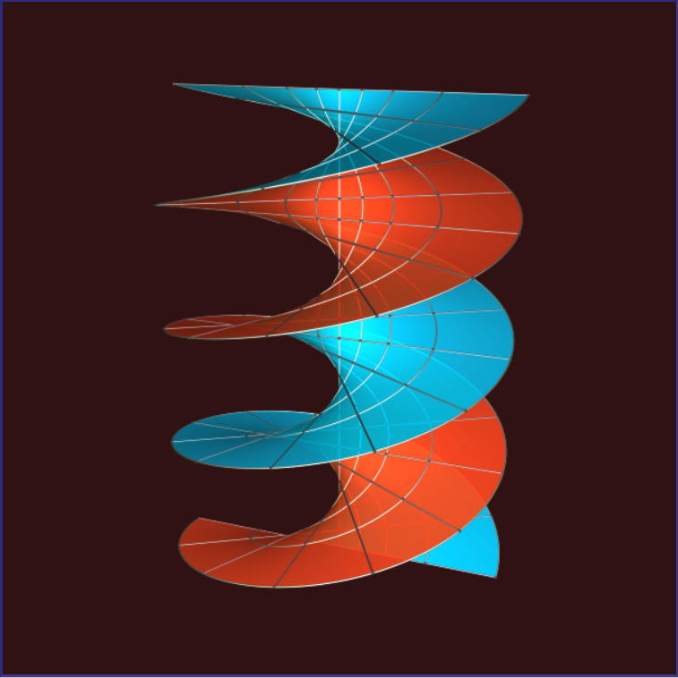
[Ex 1] Helicoid

Slide 3
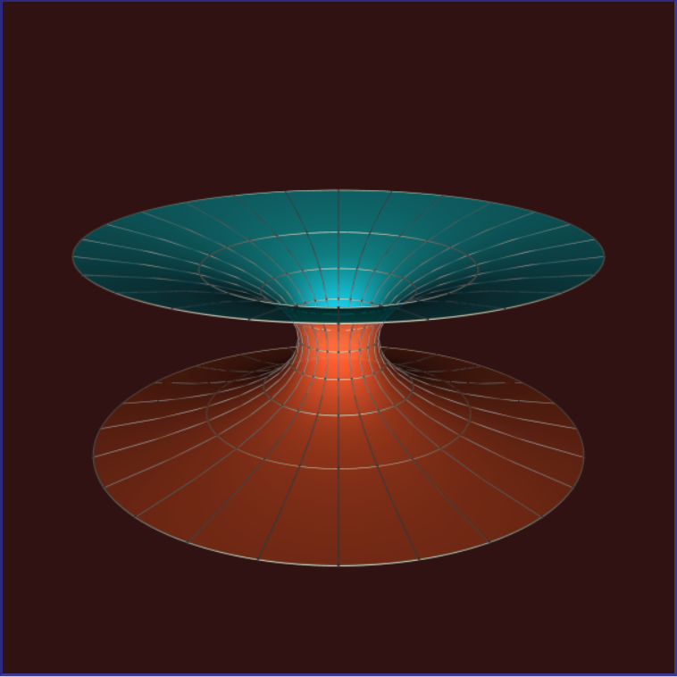
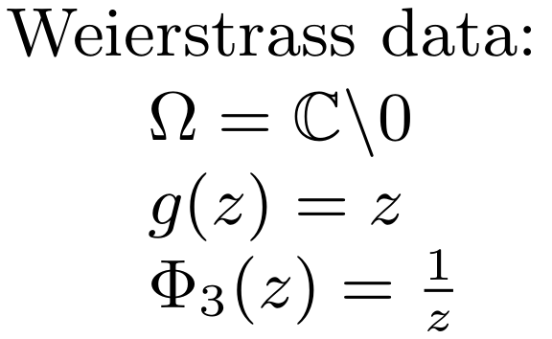
[Ex 2] Catenoid

Slide 4
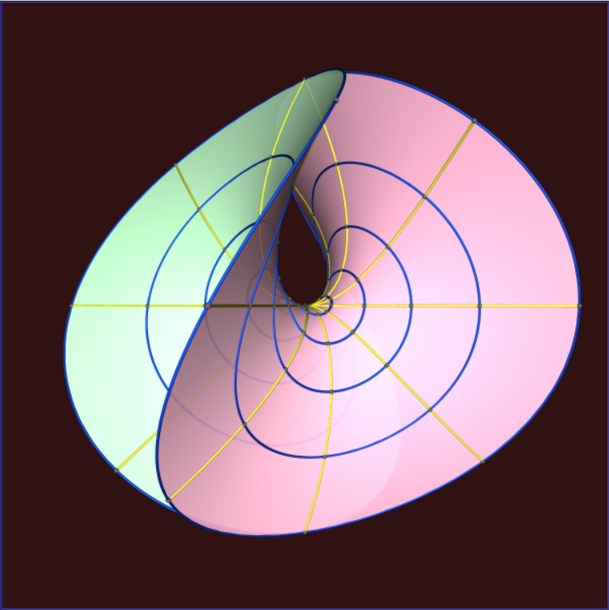
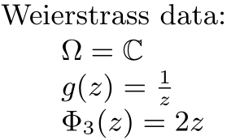
[Ex 3] Enneper’s Surface

Slide 5
Isometric deformation

